Slide 1
CS492 - Operating Systems System Calls
Georgios Portokalidis & Jun Xu
Reading: MOS Ch 1.6
Slides credit: Antonio Barbalace

Slide 2
Content
Key UNIX system calls
Process management
File management
Miscellanea
Process-to-OS communication
How a system calls is made and returns

Slide 3
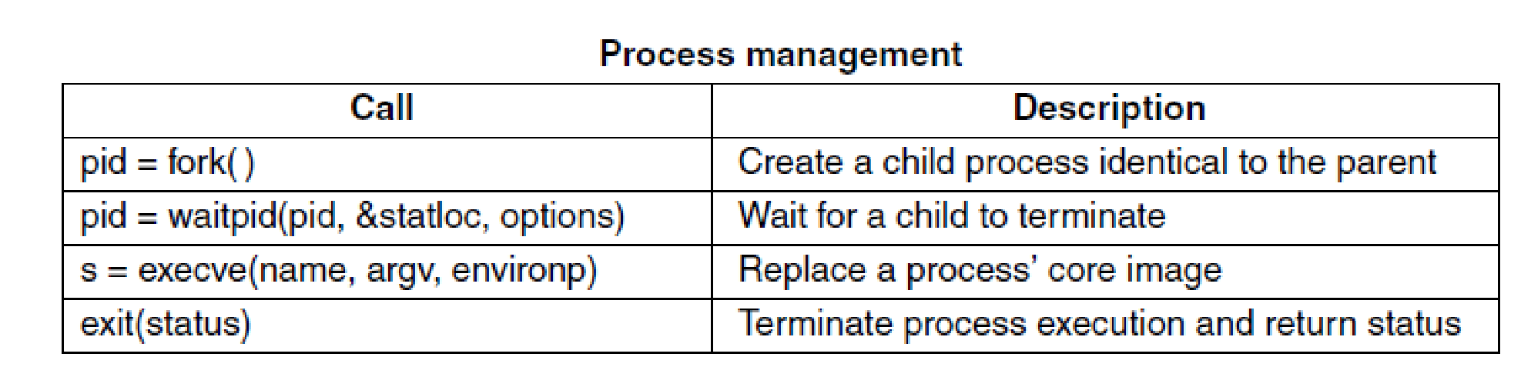
Process Management Syscalls
Some of the major POSIX system calls. (MOS Figure 1-18)
The return code s is −1 if an error has occurred
The return codes are as follows: pid is a process id

Slide 4
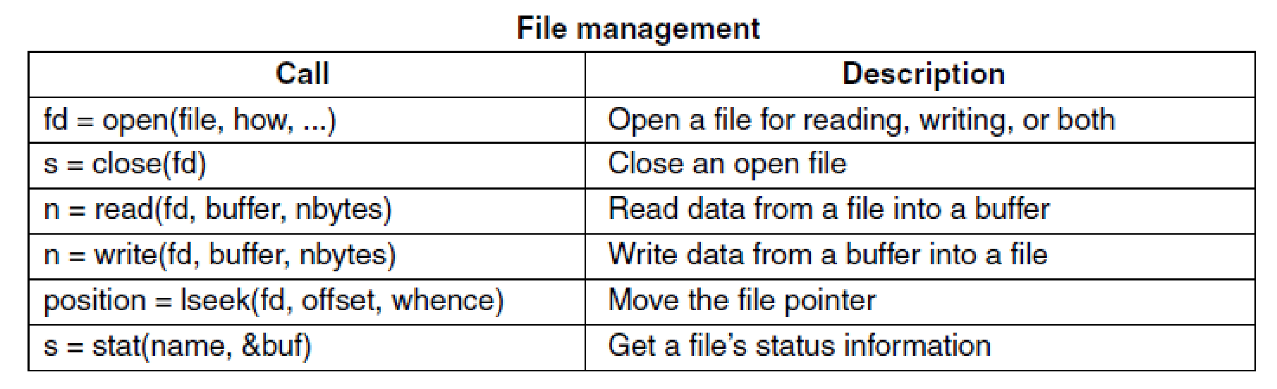
File Management Syscalls (1)
Some of the major POSIX system calls. (MOS Figure 1-18)
The return code s is −1 if an error has occurred
The return codes are as follows: fd is a file descriptor, n is a byte count, and position is an offset within the file

Slide 5
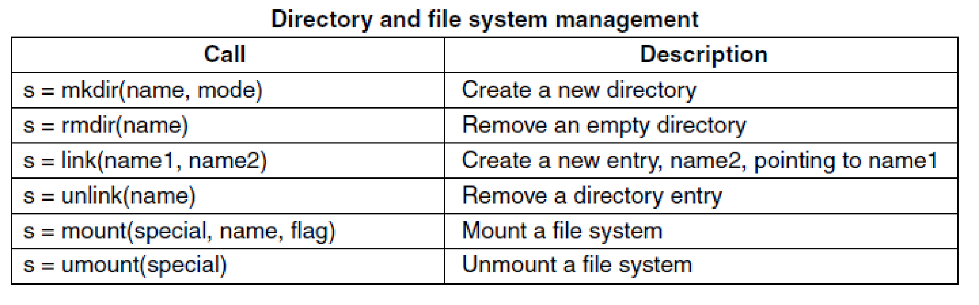
File Management Syscalls (2)
Some of the major POSIX system calls. (MOS Figure 1-18)
The return code s is −1 if an error has occurred

Slide 6
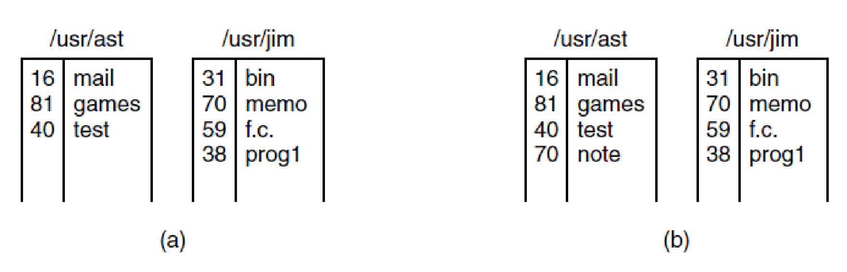
Link() Example
(a) Two directories before linking usr/jim/memo to ast’s directory. (b) The same directories after linking. (MOS Figure 1-21)

Slide 7
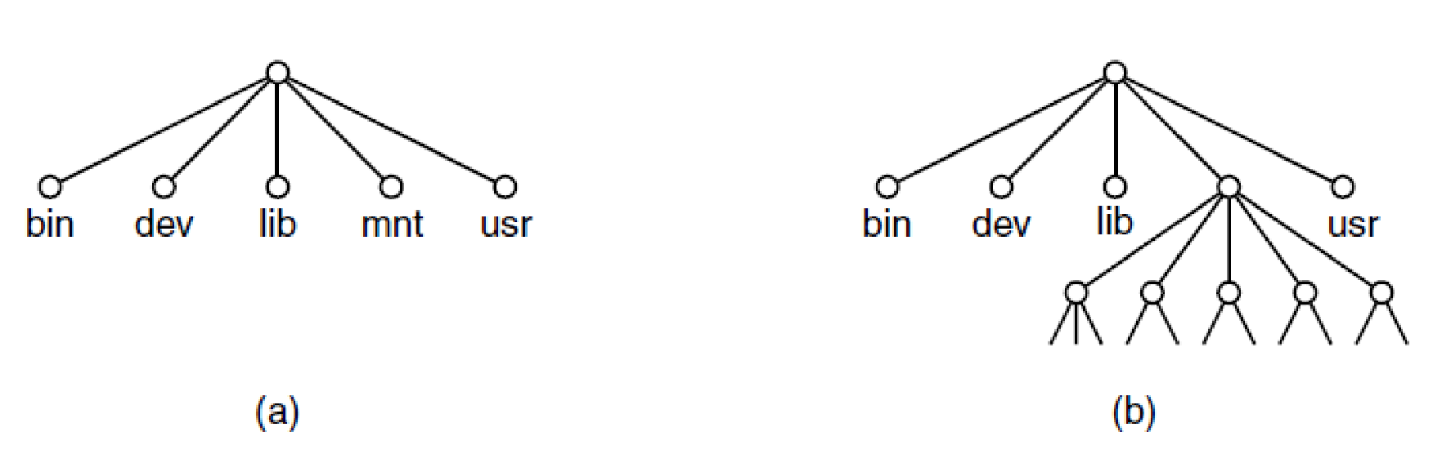
Mount() Example
(a) File system before the mount. (b) File system after the mount. (MOS Figure 1-22)

Slide 8
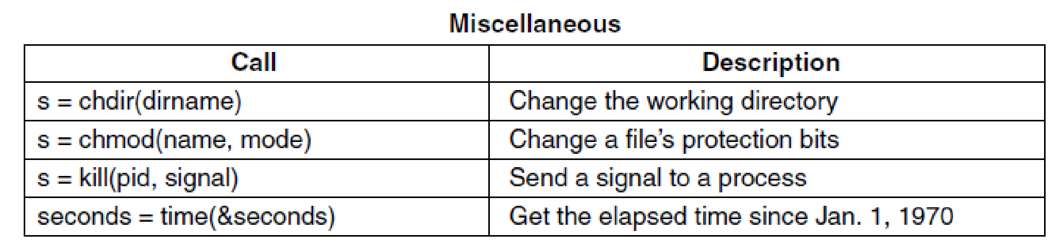
Miscellaneous Syscalls
Some of the major POSIX system calls. (MOS Figure 1-18)
The return code s is −1 if an error has occurred. The return codes are as follows: seconds is the elapsed time.

Slide 9
Process-to-OS Communication (1)
System Calls
Vary from one OS to another
Invoking a System Call (or Syscall)
When a running application needs a system service
Mechanics highly machine dependent
Assembly code
A procedure library is provided (C, other languages)
Interrupt instruction
Special machine instruction (Intel’s sysenter/sysret)
Syscalls are numbered (generally the case)

Slide 10
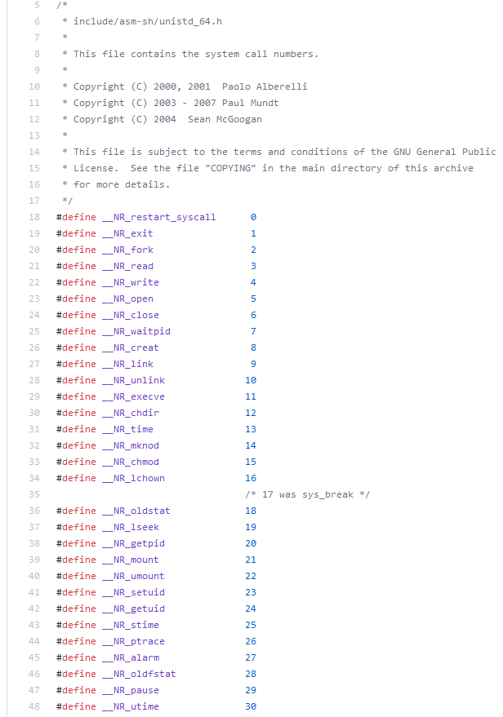
Process-to-OS Communication (2)

Slide 11
Process-to-OS Communication (3)
Switch execution context
from application code (user-space)
to operating system code (kernel-space)
Making a system call is like making a special kind of procedure call
System calls enter the kernel and procedure calls do not
The applications “asks” the operating system to do something (OS service) on its behalf

Slide 12
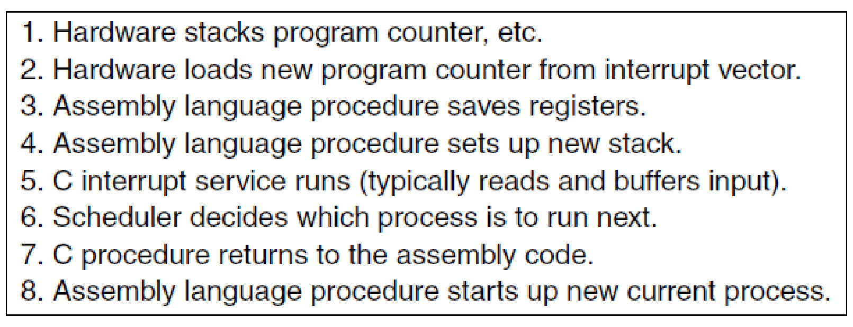
Syscall Trap/Interrupt/Exception
8. (updated) Resume execution of the next process in user-space.
Skeleton of what the lowest level of the operating system does when an interrupt occurs. (MOS Figure 2-5) (from Processes Slide Set)
Between 5. and 6. a syscall routine or interrupt/exception handler is executed

Slide 13
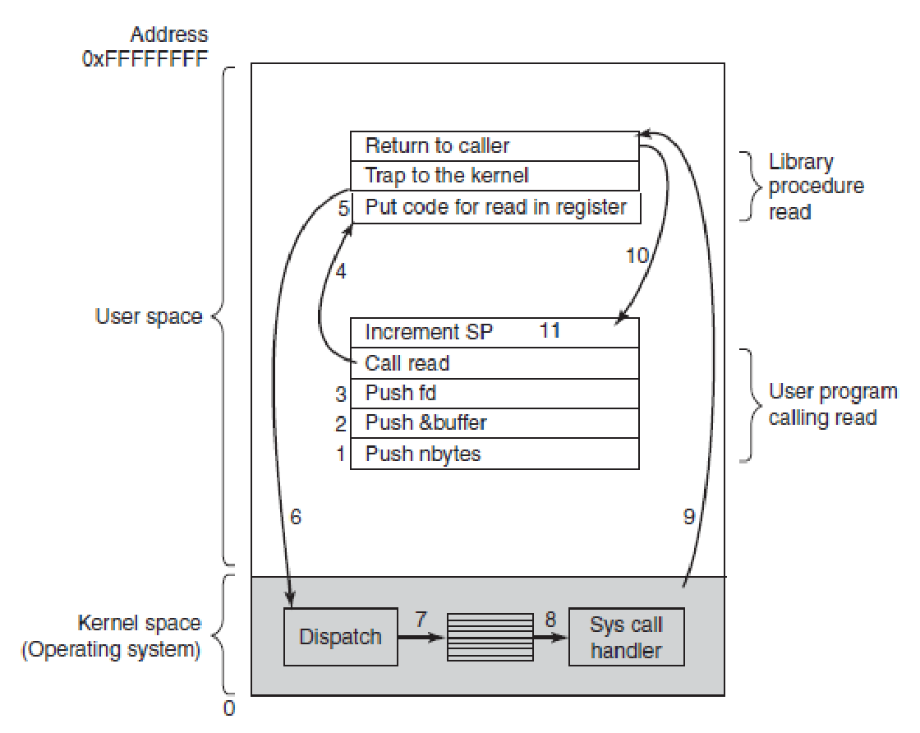
System Call Step-by-Step (1)
The 11 steps in making the system call read(fd, buffer, nbytes) (MOS Figure 1-17)

Slide 14
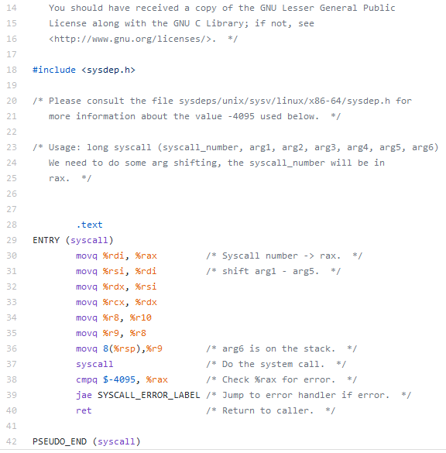
System Call From the User (libc)
https://github.com/bminor/glibc/blob/master/sysdeps/unix/sysv/linux/x86_64/syscall.S
When a syscall is not implemented you have to use this func!

Slide 15
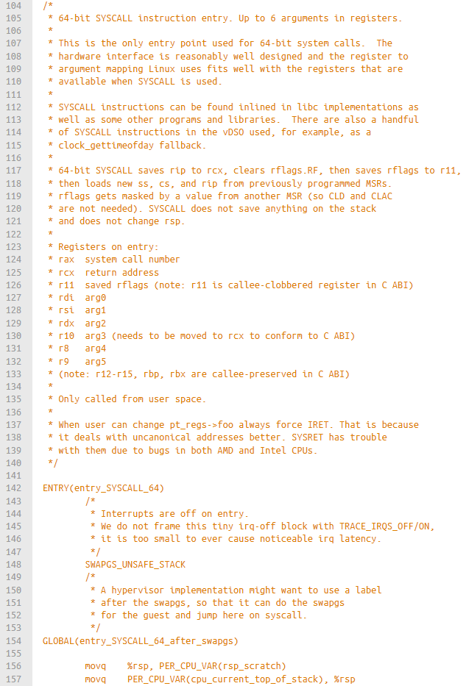
System Call From the Kernel (Linux)
https://elixir.bootlin.com/linux/v4.9/source/arch/x86/entry/entry_64.S

Slide 16
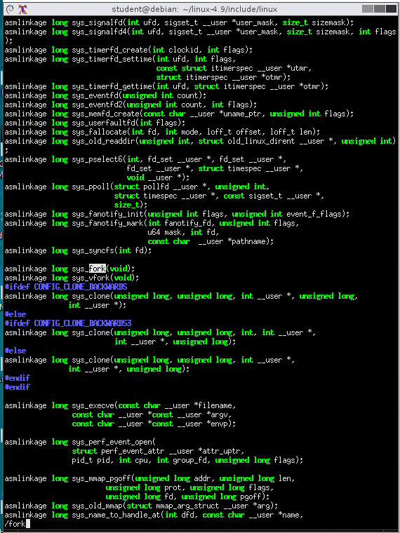
Syscalls Defs (Non-arch-specific)
For Linux kernel 4.9, the list is present in
include/linux/syscalls.h
This is a C file of prototypes

Slide 17
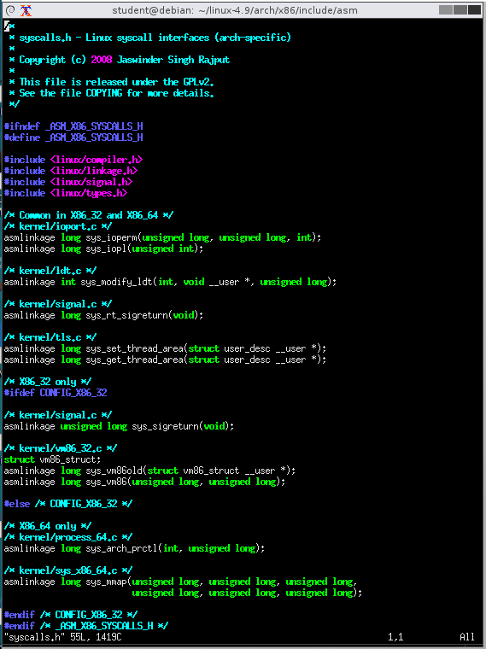
Syscalls Defs (Arch-specific)
For x86_64, Linux kernel 4.9, the list is present in
arch/x86/include/asm/syscalls.h
This is a C file of prototypes

Slide 18
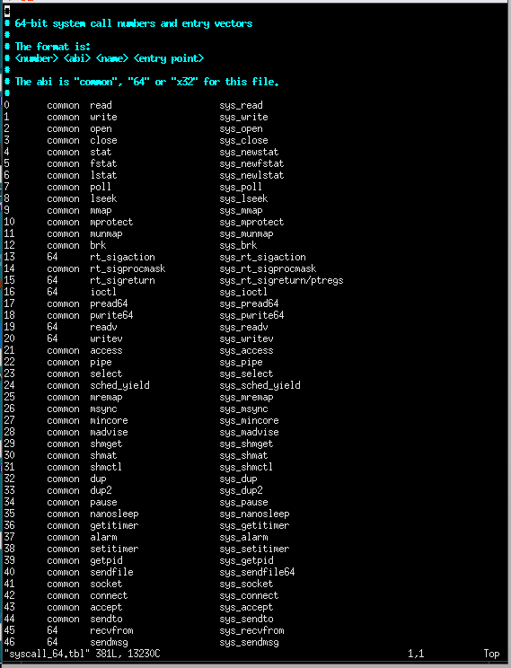
Syscalls Table (Per-architecture)
For x86_64, Linux kernel 4.9, the list is present in
arch/x86/entry/syscalls/syscall 64.tbl
The list is translated into a C source code by a script

Slide 19
Syscall Code
kernel/time/time.c
1 SYSCALL_DEFINE2(gettimeofday, struct timeval __user
*, tv, struct timezone __user *, tz)
2 {
3 if (likely(tv != NULL)) {
4 struct timeval ktv;
5 do_gettimeofday(&ktv);
6 if (copy_to_user(tv, &ktv, sizeof(ktv)))
7 return -EFAULT;
8 }
9 if (unlikely(tz != NULL)) {
10 if (copy_to_user(tz, &sys_tz, sizeof(sys_tz)))
11 return -EFAULT;
12 }
13 return 0;
14 }
Use the macro SYSCALL_DEFINE2 to declare that it is a syscall
“2” means 2 function arguments
Return value is what the syscall returns
Use copy_{to|from}_user to copy data to/from the process address space

Slide 20
Syscall Definition
#ifndef SYSCALL_DEFINE0 #define SYSCALL_DEFINE0(sname) \ SYSCALL_METADATA(_##sname, 0); \ asmlinkage long sys_##sname(void); \ ALLOW_ERROR_INJECTION(sys_##sname, ERRNO); \ asmlinkage long sys_##sname(void) #endif /* SYSCALL_DEFINE0 */
#define SYSCALL_DEFINE1(name, ...) SYSCALL_DEFINEx(1, _##name, __VA_ARGS__) #define SYSCALL_DEFINE2(name, ...) SYSCALL_DEFINEx(2, _##name, __VA_ARGS__) #define SYSCALL_DEFINE3(name, ...) SYSCALL_DEFINEx(3, _##name, __VA_ARGS__) #define SYSCALL_DEFINE4(name, ...) SYSCALL_DEFINEx(4, _##name, __VA_ARGS__) #define SYSCALL_DEFINE5(name, ...) SYSCALL_DEFINEx(5, _##name, __VA_ARGS__) #define SYSCALL_DEFINE6(name, ...) SYSCALL_DEFINEx(6, _##name, __VA_ARGS__)
#define SYSCALL_DEFINE_MAXARGS 6
#define SYSCALL_DEFINEx(x, sname, ...) \ SYSCALL_METADATA(sname, x, __VA_ARGS__) \ __SYSCALL_DEFINEx(x, sname, __VA_ARGS__)
https://elixir.bootlin.com/linux/latest/source/include/linux/syscalls.h#L215

Slide 21
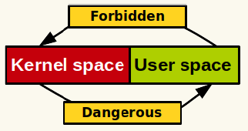
Copy to/from User (1)
Key concept in modern OSes
The program, in user-space, cannot access OS memory
The OS, in kernel-space, can access program memory
Notes:
User space cannot access kernel memory
I Kernel code should not directly access user memory
I How to exchange data with pointers ?

Slide 22
Copy to/from User (2)
The kernel access user-space’s memory with the following macros
When a kernel function gets a pointer to memory in user-space it needs to use
The kernel copies it into its memory area copy_from_user()
When the kernel wants to write in a user space buffer
It uses copy_to_user()
These functions perform checks for security and stability
1 static inline long copy_from_user(void *to, const void __user *from, unsigned long n);
2 static inline long copy_to_user(void __user *to, const void *from, unsigned long n);

Slide 23
More User Space Access APIs
https://docs.huihoo.com/linux/kernel/2.6.26/kernel-api/ch05s02.html
Function | Description
access_ok | Checks the validity of the user space memory pointer
get_user | Gets a simple variable from user space
put_user | Puts a simple variable to user space
clear_user | Clears, or zeros, a block in user space
copy_to_user | Copies a block of data from the kernel to user space
copy_from_user | Copies a block of data from user space to the kernel
strnlen_user | Gets the size of a string buffer in user space
strncpy_from_user | Copies a string from user space into the kernel

Slide 24
Adding a Syscall in Linux
Write your syscall function
In an existing file if it makes sense
If the implementation is self-contained in a new file
You will have to add your file in the Linux Makefile
Add your syscall in the architecture specific syscall table
arch/x86/entry/syscalls/syscall 64.tbl, for x86 on Linux 4.9
Add your syscall prototype in
include/linux/syscalls.h
or in the architecture specific equivalent
Recompile, reinstall, reboot the kernel
Invoking the system call from a program will trigger your code

Slide 25
…Editing a Kernel Makefile
Example
Syscall implemented in the Linux sources in
my_syscall/my_syscall.c
my_syscall/Makefile
obj-y += my_syscall.o
Linux root Makefile
1 # ...
2 core-y += kernel/ mm/ fs/ ipc/ security/ crypto/ block/ my_syscall/
3 # ...

Slide 26
Can I Call a Syscall From the Kernel Itself?
Yes, with the name in 4th column in the syscalls table
arch/x86/entry/syscalls/syscall 64.tbl
Example
For
SYSCALL_DEFINE2(gettimeofday, struct timeval __user *, tv, struct timezone __user *, tz)
Use
sys_gettimeofday
However, you are not supposed to do that
And you may not be able to call a syscall from a kernel module itself

Slide 27
Do You Really Need a New Syscall?
Pros
Easy to implement and use, fast
Cons
Needs an official syscall number
Interface cannot change after implementation
Must be registered for each architecture
Probably too much work for small exchanges of information
Alternative
Device or virtual file
User/kernel space communication through read, write, ioctl

Slide 28
Updates on zyBook Activities
3-Introduction-of-processes
New due date 2/19/2021
Chapters 2.1, 2.2, and 2.3 (new)
4-process-management
New due date 2/22/2021
Chapters 2.4, 2.5

